Slide 1
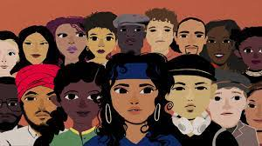

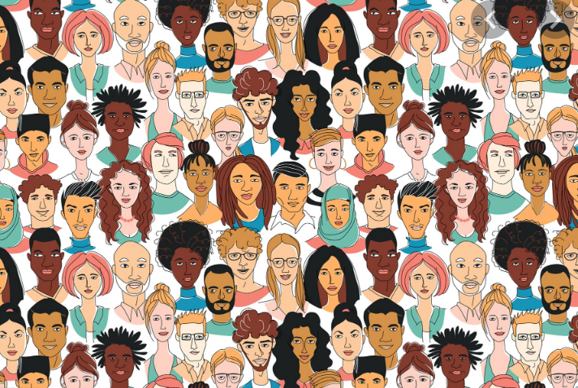
RACE, RACISM & CRITICAL RACE THEORY
WHAT DO WE REALLY KNOW?

Slide 2
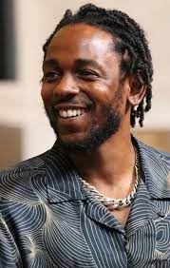
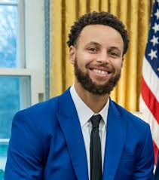

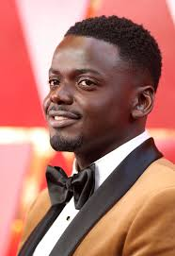
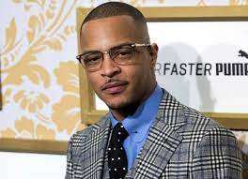
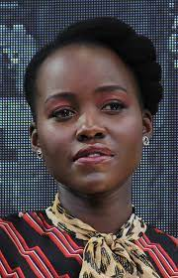
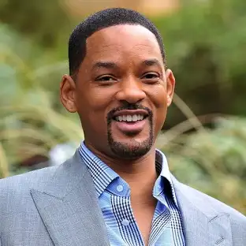
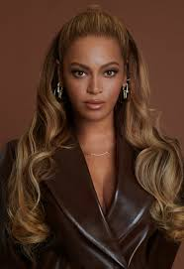
What is Race?
a group of people who have in common some visible physical traits, such as skin color, hair texture, facial features, and eye formation.

Slide 3

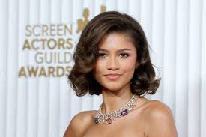
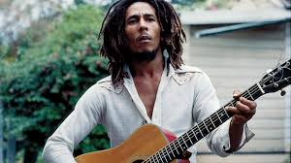
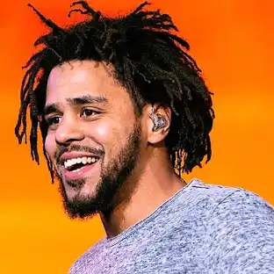
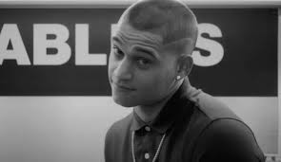
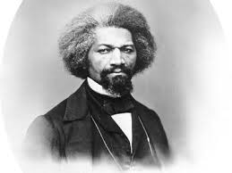
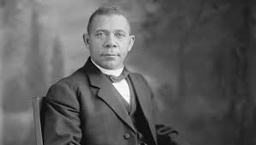
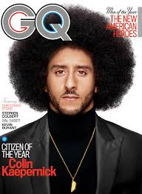
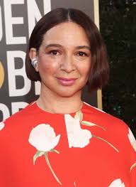
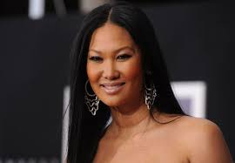

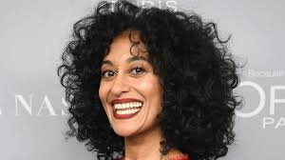
Why is race so prevalent in our society?

Slide 4
THE ONE-DROP RULE
To eliminate the potential for light-skinned black individuals passing as white individuals, many state officials categorized any person with one drop of black ancestry as a black person. Specifically, Jim Crow Laws defined a black individual as anyone with any African ancestry. This one-drop rule became the social and legal principle of racial classification in the United States. Anyone with even a single ancestor of African descent was considered a black individual (negro in historical terms). This certainly seems scientifically unsound since every human alive today can trace their ancestry back to individuals who migrated from Africa (33).
The one-drop concept evolved during the 19th century and became the law of many states. Tennessee was the first state in 1910 to place the one-drop rule into law. Louisiana, Texas, Arkansas, Mississippi, North Carolina, Virginia, Alabama, Georgia, and Oklahoma followed. Florida, Kentucky, Maryland, Missouri, Indiana, Nebraska, North Dakota, and Utah amended their old “blood fractions” to one-sixteenth or one-thirty-second which is nearly the equivalent of the one-drop rule. Thus, in 1911, for example, Arkansas passed Act 320 (House Bill 79), which defined as “Negro” anyone “who has…any negro blood whatever.”
Virginia and other states began to classify people only as black or white. For example, in 1912 Virginia lawmakers established the Bureau of Vital Statistics and enacted strict segregation laws and a prohibition on interracial marriage

Slide 5
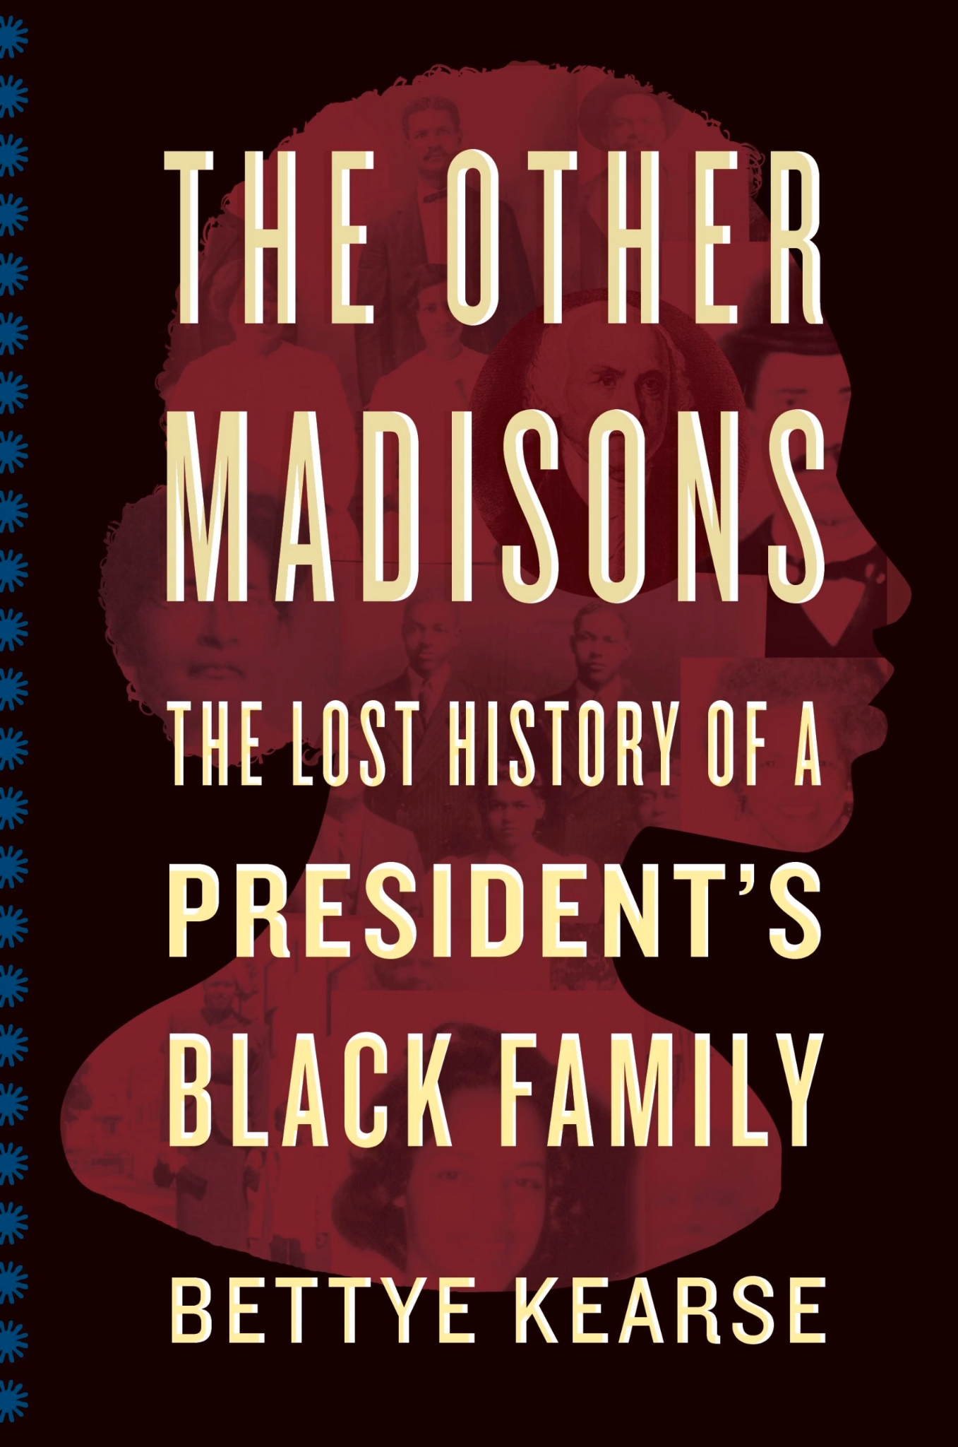
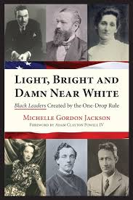
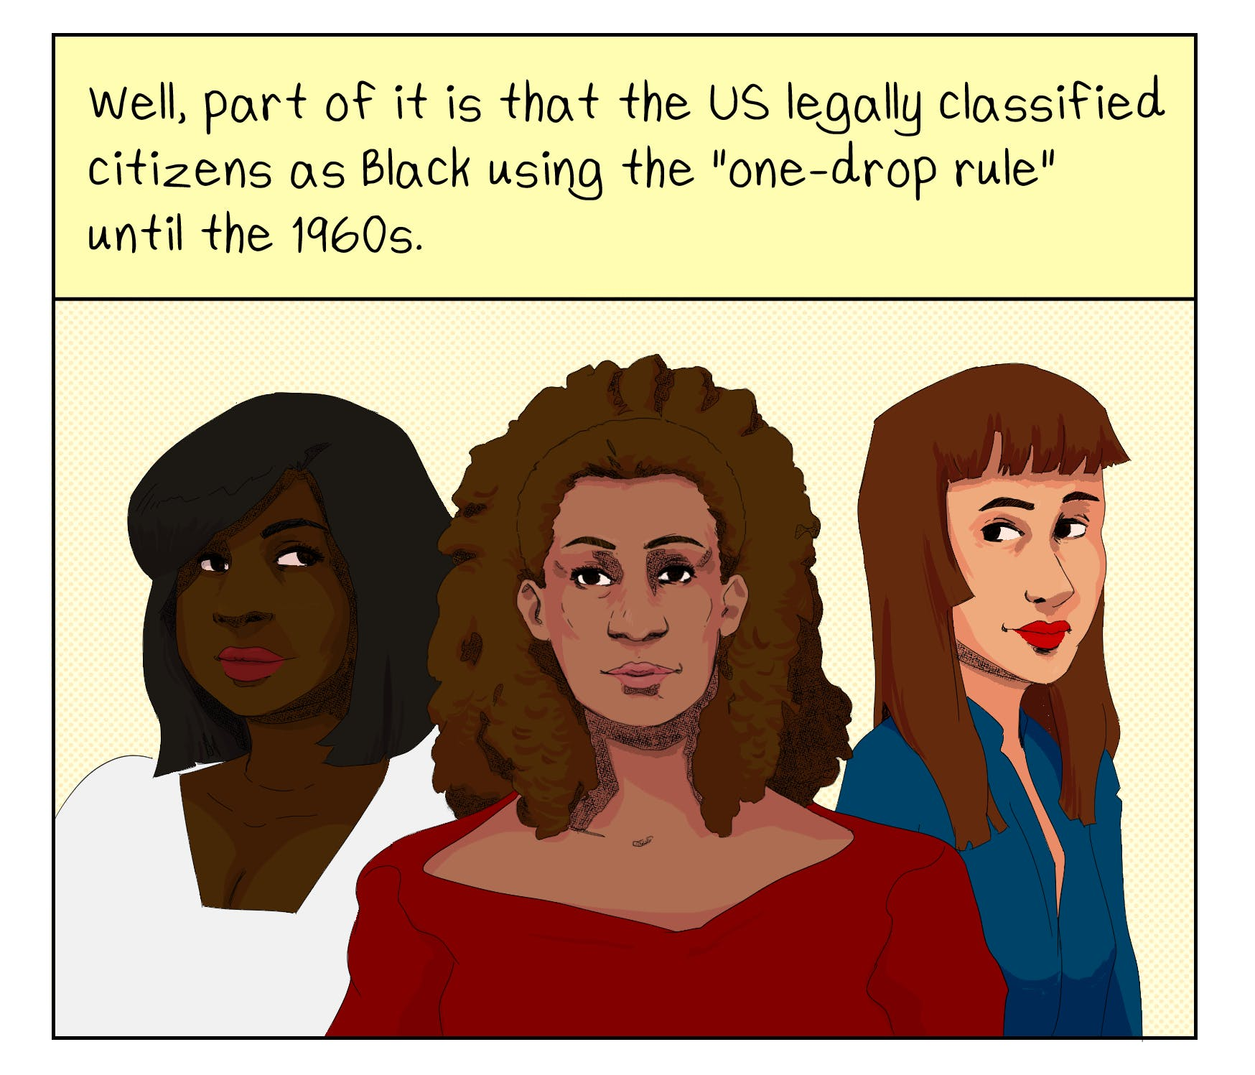
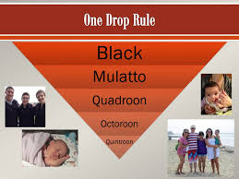
One Drop Rule
The racist “one drop rule” influencing science: it is time to stop teaching “race corrections” in medicine
Who is Black? One Nation's Definition
Vice President Harris’ views on her identity are pushing the U.S. public to look beyond entrenched, problematic racial boundaries
Hypodescent: The “One-Drop” Rule
How the One Drop Rule and Blood Quantum Show Just How Made-Up Race Really Is
Halle Berry Cites 'One-Drop' Rule in Battle Over Whether Her Daughter Is Black or White

Slide 6


Slide 7
SOUTH AFRICA
In South Africa, race is still often defined by the categories established during apartheid, which are "Black," "White," "Coloured," and "Indian," primarily based on physical appearance and ancestry, even though the system is no longer legally enforced; this classification is used for data collection and to identify historically disadvantaged individuals, despite criticism about its continued relevance in a post-apartheid society.
How Tyla’s rise sparked a debate around racial identity
Tyla’s racial identity: South African singer sparks culture war
Apartheid Musuem

Slide 8
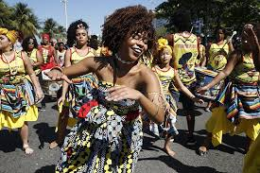
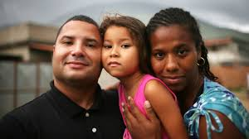
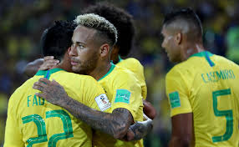
BRAZIL
In Brazil, race is primarily defined by a person's physical appearance/skin tone, categorized into five official racial groups according to the Brazilian Institute of Geography and Statistics (IBGE): "branco" (white), "pardo" (brown or multiracial), "preto" (black), "amarelo" (yellow/Asian), and "indígena" (indigenous), with classification often based on skin color rather than strict genetic ancestry due to the country's history of miscegenation; meaning that someone's racial identity can be influenced by factors like class and social status beyond just their genetics.

Slide 9
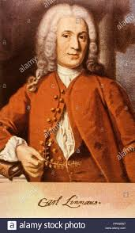
Carl Linnaeus (Sweden) 1707 -1778
The FOUNDATION OF CLASSIFYING THE VARIOUS RACES
Homo Americanus - reddish, choleric (bad temper), obstinate (stubborn), contended and regulated by custom
Homo Europaeus as white, fickle, sanguine (optimistic, positive), blue-eyed, gentle and governed by laws
Homo Asiaticus as sallow (yellowish), garve dignified, avaricious (greedy), and ruled by opinion
Homo Afer as black, phlegmatic (unemotional), cunning, lazy, lustful, careless and governed by caprice (inconsistent)

Slide 10
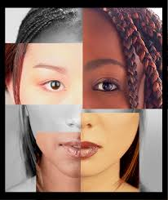
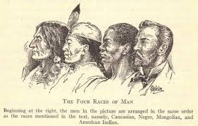
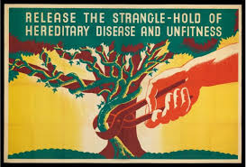
CARL LINNAEUS
How Scientific Taxonomy Constructed the Myth of Race
‘Linnaeus was definitely a racist’

Slide 11
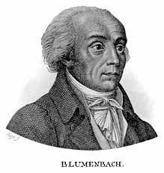
Johann Friedrich Blumenbach (Germany) 1752-1840
The Caucasian or white race - People of European origin and later would be reinterpreted to include Middle Easterners, North Africans, and South Asians
The Mongolian or yellow race - Including all East Asians and some Central Asians
The Malayan or brown race - Including Southeast Asian and Pacific Islanders
The Ethiopian or black race - including sub-Saharan Africans
The American or red race - including all indigenous Americans

Slide 12
What is a SOCIAL CONSTRUCT?
A Social Construct - an idea or practice that has been created and accepted by the people in a society sometimes forcibly and other times willfully.

Slide 13
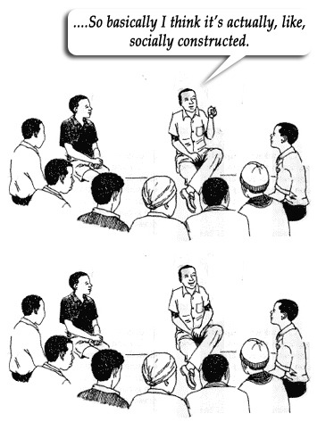
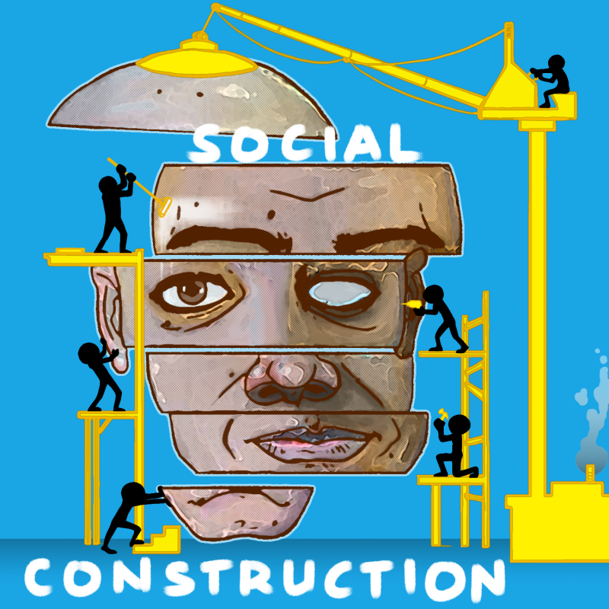
WHERE DO WE SEE SOCIAL CONSTRUCTS?
Shaking hands as a formal greeting
Graduation Ceremonies
Beauty standards
Education
Marriage
Money/Economics
Time
Gender Roles

Slide 14
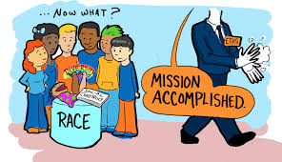
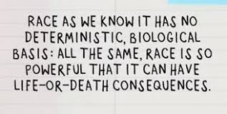
How Has Race Been Divisive Throughout Time?
Social & Political Outcomes
Jobs
Housing
The Institution of Slavery
The Creation of Stereotypes
Education

Slide 15
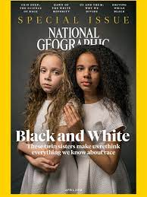
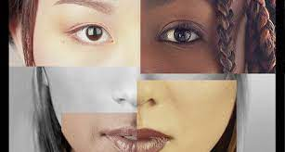
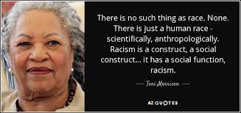
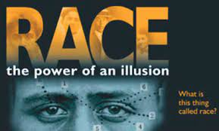
Reasons Why Race is a Social Construct
The genetic diversity that exists across the entire human race is very, very small.
Race has changed several times and probably will change again. Example - people of Mexican ancestry were white until the 1930 census. Later in 1933 there was a debate on whether people from Japan were white.
In the United States there was the classification of being black as a having “one drop” of black blood.
At one point Germans, Greeks, Irish, Italians and Spaniards are were considered “not quite white” and excluded from the white category
America uses the Census as the determining factor to get accurate information of the racial makeup of the nation. Why is this a flawed method of obtaining data regarding race?
DNA tests can not measure race. It can give you where your ancestors came from, but not your race.

Slide 16
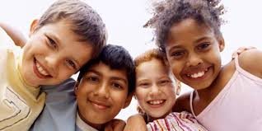
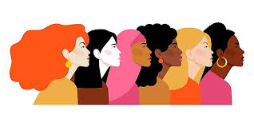
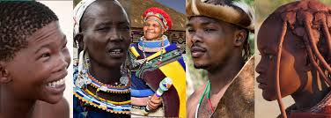
WHAT IS ETHNICITY?
Ethnicity differs from race. It is more so deals with traditions, customs, language, heritage, religion, holidays, national origin, ancestry etc. shared among a group of people.

Slide 17
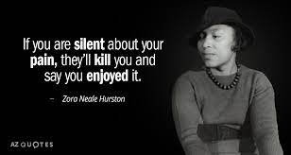
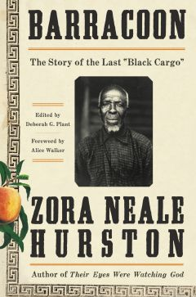
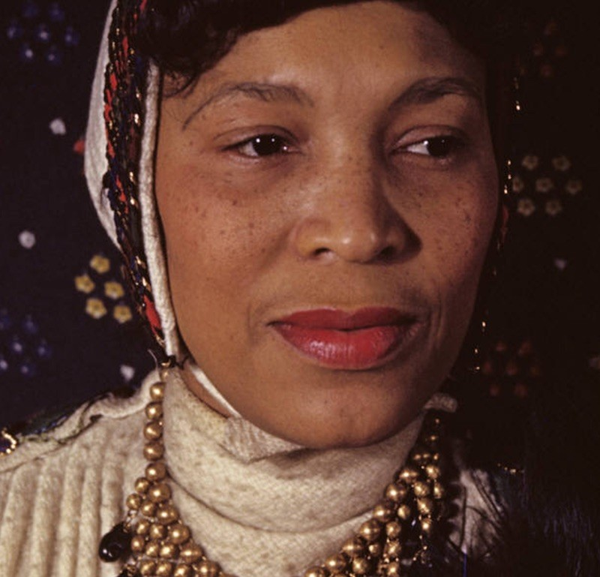
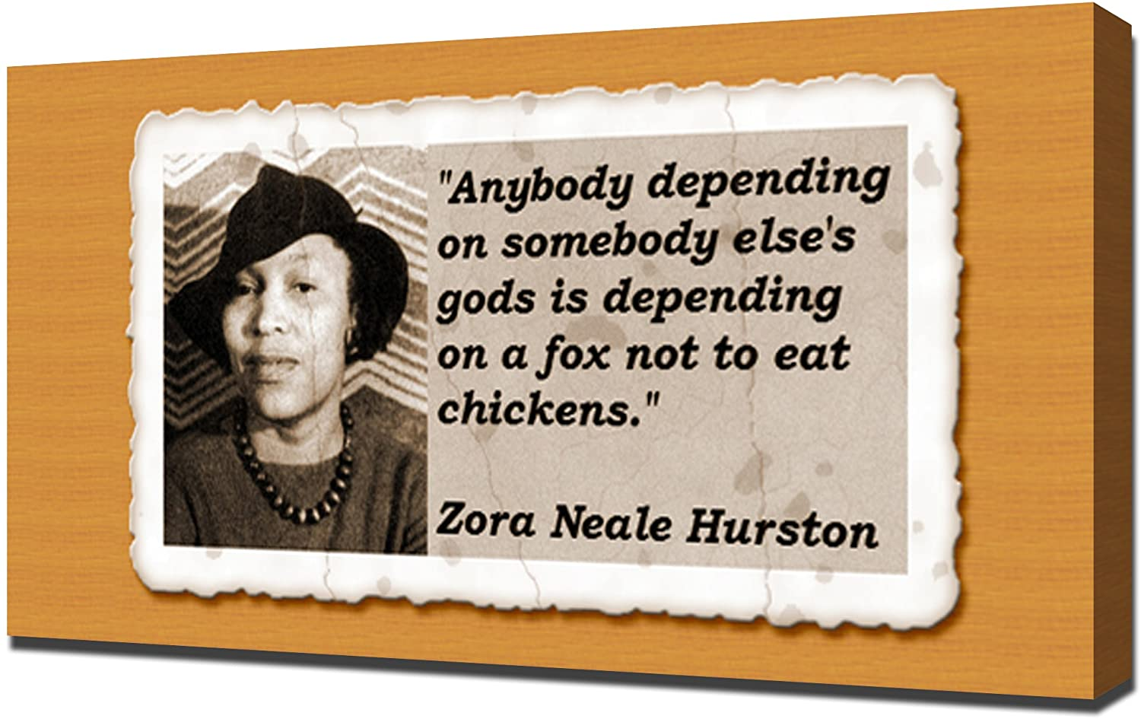

Zora Neale Hurston 1891-1960

Slide 18
Scientific Evidence of the non-existence of “Race”
How Science and Genetics are Reshaping the Race Debate of the 21st Century
Biologically, Race is Really Only Skin Deep
INTERVIEW WITH ALAN GOODMAN
What Science Says About Race and Genetics
Mitochondrial Eve: The Mother of All Human Beings
Race Is Real, But It’s Not Genetic
‘Race’ is an invented concept, but an impactful one, researchers say

Slide 19
“There could be something wrong with me because I see Negroes neither better nor worse than any other race. Race pride is a luxury I cannot afford. There are too many implications bend the term. Now, suppose a Negro does something really magnificent, and I glory, not in the benefit to mankind, but the fact that the doer was a Negro. Must I not also go hang my head in shame when a member of my race does something execrable? If I glory, then the obligation is laid upon me to blush also. I do glory when a Negro does something fine, I gloat because he or she has done a fine thing, but not because he was a Negro. That is incidental and accidental. It is the human achievement which I honor. I execrate a foul act of a Negro but again not on the grounds that the doer was a Negro, but because it was foul. A member of my race just happened to be the fouler of humanity. In other words, I know that I cannot accept responsibility for thirteen million people. Every tub must sit on its own bottom regardless. So 'Race Pride' in me had to go. And anyway, why should I be proud to be Negro? Why should anyone be proud to be white? Or yellow? Or red? After all, the word 'race' is a loose classification of physical characteristics. It tells nothing about the insides of people. Pointing a achievements tells nothing either. Races have never done anything. What seems race achievement is the work of individuals. The white race did not go into a laboratory and invent incandescent light. That was Edison. The Jews did not work out Relativity. That was Einstein. The Negros did not find out the inner secrets of peanuts and sweet potatoes, nor the secret of the development of the egg. That was Carver. If you are under the impression that every white man is Edison, just look around a bit. If you have the idea that every Negro is a Carver, you had better take off plenty of time to do your searching.”
― Zora Neale Hurston, Dust Tracks on a Road

Slide 20

Discussion Question of the Day
What is your definition of the word racism?

Slide 21
Professor Ka-Re’s Definition of Racism
(Verb) Racism is systemic (a number of years) oppression, that manifests overtly and covertly, in which a “marginalized group” is excluded from or is presented with extraordinary obstacles, either by law, policy or by practice, when trying to make advancements in society by people in power, strictly because of their race.

Slide 22
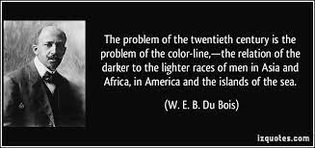

Slide 23
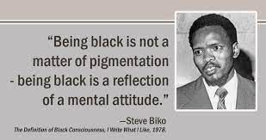

Slide 24
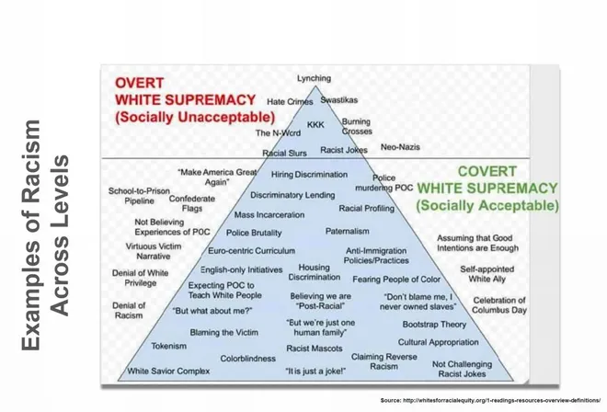

Slide 25
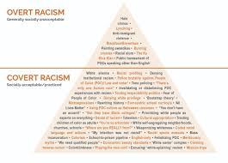

OVERT AND COVERT RACISM
Overt and Covert Racism(CLICK ON THIS LINK)

Slide 26



Discussion Questions
Do you see race when you look at someone?
Do Black and other non-white people put too much emphasis on race?
Do you see racism getting better, worse or staying the same ?
What continues to feed racism?
How can race be divisive?
Can a racist be rehabilitated?
Is race discussed too much in our society?

Slide 27



CODED LANGUAGE
The sneaky language today's politicians use to get away with racism and sexism
Coded Language Is Part of Our Racist Education System
Black on Black Crime
Woke
DEI Hire
Angry
Thug
Urban
States Rights
At Risk Youth
Achievement Gap
Reggin
Welfare Queens
Low Income Communities

Slide 28


Slide 29


Slide 30


The United Independent Compensatory Code/System/Concept
A Textbook/Workbook for thought, speech, and or action for victims of racism (white supremacy)
Racism has done more to promote non-justice than any other socio-material system system know have been produced or supported by the people of the known universe.
The fear, frustration, malice and confusion caused by racism, retards or prevents all constructive activity between the people of the known universe.
The people who have the ability to eliminate racism, do not have the will to do so, and the people who have the will to do so, do not have the ability .
As long as Racism exists, anything said or done by people that is not intended to help eliminate racism and to help produce justice, is a waste of time and energy.

Slide 31





9 Major Areas In Which Racism Manifests - Nelly Fuller Jr.
Economics
Education
Entertainment
Labor
Law
Politics
Religion
Sex
War/Counter War

Slide 32

The ISIS PAPERS - The Keys To The Colors (Welsing)
Dr. Frances Cress Welsing
The Cress Theory:
Racism is not an attitude, it is an prejudicial view, or even racial hatred. Racism is supremacy, and is a global power system of mass oppression of white genetic survival.
Black Fear
Sexual Envy

Slide 33


Slide 34
IN CLASS READINGS
ARTICLES RELATED TO THE AP AFRICAN-AMERICAN CLASS
What’s Really in the AP African-American Studies Class DeSantis Rejected? (Politico Article)
College Board's revised AP African American studies course draws new criticism (NPR ARTICLE)
WHY ARE STATES BANNING "CRITICAL RACE THEORY"
Florida rejected AP African American Studies. Here's what's actually being taught in the course
America's Censored Classrooms
Teachers, students speak out against Texas laws targeting critical race theory
STANDARDS OF AFRICAN AMERICAN HISTORY IN FLORIDA
AFRICAN AMERICAN HISTORY STANDARDS IN FLORIDA

Slide 35





CRITICAL RACE THEORY - WHAT IS IT EXACTLY?
It started in the late 1970’s by a progressive group of lawyers from prestigious universities. Derrick Bell, Alan Freeman, Kimberle Crenshaw, Richard Delgado, Cheryl Harris, Charles R. Lawrence III, Mari Matsuda, Patricia J. Williams
It is a theoretical framework on how we examine structural and racial disparities and how they came to be and how racism is embedded in laws and policy. It studies race from a systemic vantage point.
Critical Race Theory (CRT) is a discipline and analytical tool primarily used in university-level law courses. It looks at policy and law and how racial overtones have been in place in laws from the inception of the country. Originating in the 1970s, CRT was first used as a tool to help law students think critically about the impact of historical and present-day racism on the legal system.
CRT is not an emotional examination.
What is the end goal of CRT?
What Does ‘Woke’ Even Mean? How A Decades-Old Racial Justice Term Became Co-Opted By Politics
Just the tip of the iceberg’: Kimberlé Crenshaw warns against rightwing battle over critical race theory
Ideas that make up critical race theory have been around long before it got its name
What Is Critical Race Theory, and Why Is It Under Attack?
What Is Critical Race Theory, and Why Is Everyone Talking About It?
AT LIBERTY PODCAST Kimberlé Crenshaw on Teaching the Truth about Race in America
I See My Work as Talking Back”: How Critical Race Theory Mastermind Kimberlé Crenshaw Is Weathering the Culture Wars
THE PICTURE TO THE RIGHT THAT SAYS DECOCRACY NOW! IS ACTUALLY A VIDEO

Slide 36






Discriminatory Laws and Policy
Virginia Slave Code 1662
Virginia Slave Code 1669
Fugitive Slave Act of 1793
The Black Codes
Jim Crow Laws - 1876-1965
Convict Lease System
Literacy Test
Grandfather Clause
Poll Tax
The Day Law (Kentucky) 1904-1954
Plessy Versus Ferguson 1896
Redlining
Stop and Frisk

Slide 37


Slide 38


Slide 39


